Slide 1
Sustainable Management and Development for the Cubango Okavango River Basin: Building Community Resilience
Namibia
Christian, Paige, One, Lucia, Imagen, Sarah – ASU, UNSW, ORI
July 6, 2025

Slide 2
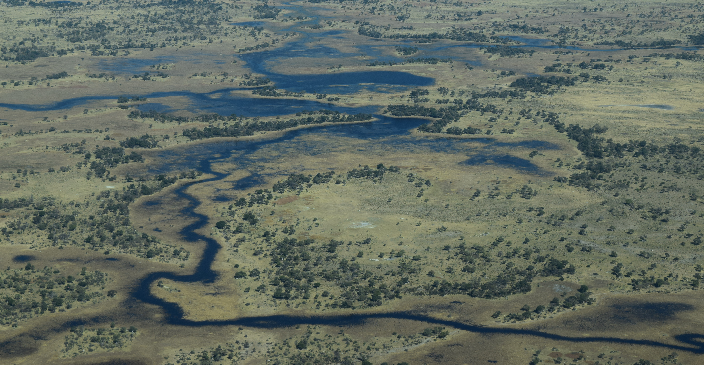
Introduction to the Cubango Okavango River Basin

Slide 3
The Cubango Okavango River Basin
The basin is 13500km2 in area
Semi arid climate
Globally important for biodiversity
Headwaters in Angola, Runs through North East Namibia and flows into North West Botswana.
The local people of the region are the San people, however, other groups have migrated in over time, such as the Setswana.
OKACOM is the main water management agency, however all countries also manage their own sections of the basin.

Slide 4
Country Context: Spotlight on Namibia
Arid country – 92% very-semi arid. Namibia is the driest nation in Sub-Saharan Africa, and is getting hotter and drier
Rainfall variable – 278mm/year average; high of 650 mm in North East and less than 50mm in the South West.
Average temperatures vary between 14-24 degrees
Namibia is a poor country, with a annual GDP around $13 billion USD. Tertiary industry the most important, followed by Mining and Agriculture.
Bordered by Angola, Zambia, Botswana and South Africa. Only a small part of the panhandle, but essential.
Local people include the Ovambo, Kavango, Herero and Himba people
Most of the water is used by agriculture and domestic use.
Has clean drinking water, however sanitation needs improvement
6.9% of Namibia’s GDP is from tourism
43.3% of the population in Namibia faces multidimensional poverty (NPR Report)
Goals for water use and development align with SDG 6 goals, however is yet to succeed with any, and is behind trajectory for the 2030 goal completion date.

Slide 5
Sustainable Management and Development for the Okavango Delta
Building Resilient Communities for Namibia

Slide 6
Our Values and Guiding Principles: Improved Livelihoods and Ecological Conservation
Water Security and Sustainability
Water for a desert nation, experiencing climate change
Water to support agriculture
Water for biodiversity in the Okavango, ecological protection
Economic development
Increased agricultural yields through farming methods (land use and sustainable agriculture)
Community mutual resource management
Sustainable tourism

Slide 7
Stakeholder Identification & Analysis
WWF-Namibia (World Wide Fund for Nature)
Funding and technical help to communal conservancies
NASCO (Namibian Association of CBRNM Support Organizations)
Community Wildlife management
Multiorganizational
Ecological research

Slide 8
Stakeholder Identification & Analysis
Private Farmers
Rely on clean water from basin
Ministry of Environment and Forestry
Encourage tourism with Conservation
Oversee tourism policy

Slide 9
Proposed Sustainable Development Strategy
Tackling each area of focus:
- Agriculture
- Water Management
- Tourism
- Local Communities
- Policy

Slide 10
Sustainable Management and Development of Agriculture
High interest & high power
Working with NGOs to implement more sustainable farming techniques
Building trust and relationships with on the ground partners
Education
Continued incentives through tax breaks and subsidies
Future: native & less water intensive agriculture

Slide 11
Timeline
Agriculture
2026 – Start working with NGOs, implementing sustainable farming practices with on-the-ground partners, and distributing educational materials
2028 – implement tax breaks and subsidies to continue funding and incentivizing programs
2035 and beyond – Introduce and popularize better adapted game farming animals

Slide 12
Sustainable Management and Development of Water
Water security for an arid nation
2026 – work with SADC, African Union, EU to diversify water supply
2026 – Improve water monitoring
2030 – expanded desalination plants provide water
2035 – wastewater recycling
Ongoing – improved sanitation
Outcomes:
Healthy Okavango River Basin
Reliable water access for Namibia

Slide 13
Sustainable Management and Development for Tourism
Partnering with tourist agencies to monitor water quality and biodiversity
- high interest

Slide 14
Sustainable Management and Development for Communities
Improving community livelihoods through Community –based Natural Resources Management by
Improving tourism & agriculture
Indigenous knowledge and scientific intertwined strategies
Community forums

Slide 15
Timeline
Communities
Improving tourism and agriculture
2026 – Initiate community forums
2027 – Implement special allowances
2028 and beyond – Incorporate indigenous knowledge into natural resource management and increase documentation of traditional strategies

Slide 16
Policies to Align with OKACOM
Develop policies for our management of the basin as climate change progresses
Expand upon National Biodiversity Action Plan
Initiate further anti-poaching regulations

Slide 17
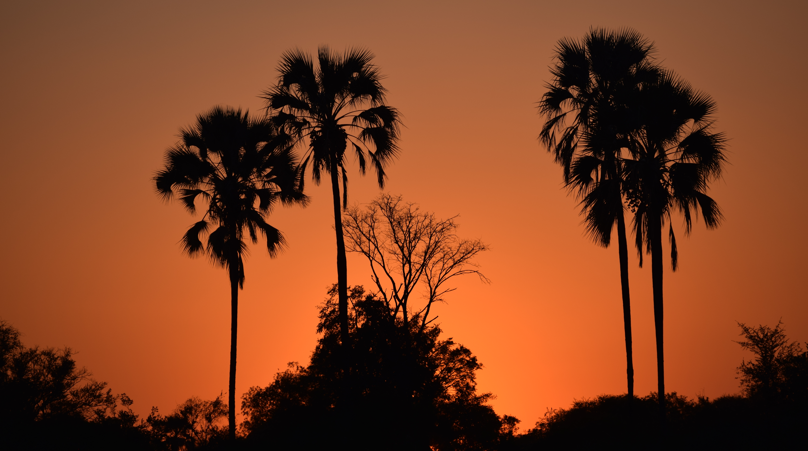
Conclusion and Recommendations

Slide 18
Conclusion and Recommendations
We take a multi-faceted approach to promote improved livelihoods and ecological conservation
- Agriculture, water, tourism, communities, and policies
Investment from NGOs and government partners
Intent to re-evaluate for adaptive management
Continue transboundary collaboration

Slide 19
Stakeholder Question & Answers

Slide 20



Holding Page for Executive Summary / Presentation Overview
Tbc last once final content is agreed
Note: all formatting (including colours and font size) to be edited/reviewed once text is agreed

